Slide 1
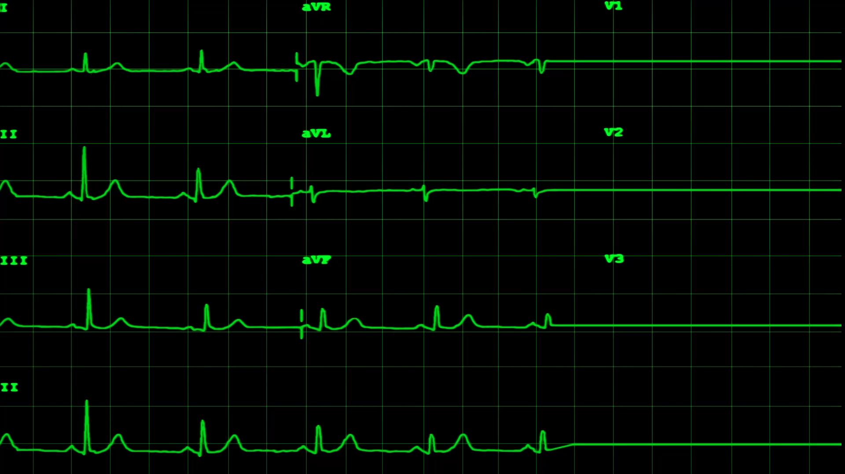
MACHINE-LEARNING AUDIO SURVEILLANCE INTEGRATED SYSTEM (MALASIS)
05 October 2021
Jacob Attia Zachary Tauscher Caleb Leeb Jaclyn Welch

Slide 2
Overview
Introduction
Design Considerations
System Architecture
Sub-System Design
Project Timeline
Parts List

Slide 3


Slide 4
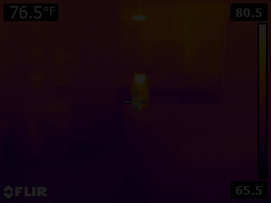

Slide 5
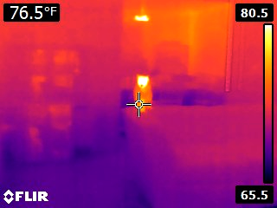
Cat: “Bubbles”
x:34.6 y:12.0

Slide 6
Introduction
Beneficial use cases
Could be trained to respond to emergencies
Elderly patients in a nursing home, triggering call for aid
Alerting parents to baby monitor
Importance of such a product on the market
Provides an additional option of surveillance
In some cases, audio surveillance might be preferable to video surveillance
Can be used in conjunction with video surveillance for higher accuracy
Audio surveillance is the ideal option during non-business hours (when the lights are off)

Slide 7
Design Considerations
Assumptions & Scope
Single room solution
Training data will require quiet room
Excessive noise or background will decrease accuracy of solution
Possibility of monitoring room without physical access
Design Constraints
Modularity
Concealment
Access to pure sound

Slide 8
System Architecture
High Level Architecture
The goal of the system is to record sounds with at least 3 three different microphone arrays, each consisting of at least 3 microphones, and transfer the audio to a Raspberry Pi with bluetooth capabilities
The Raspberry Pi transfers information to a computer with, which will then visualize the data for a user to view using Anaconda
The view displays a basic map of room in question, indicates the types of sounds picked up (such as footsteps or voices), and shows the locations of the sounds on the map
Major Subsystems
Sound Collection Sub-System
Communications Sub-System
Data Processing Sub-System

Slide 9
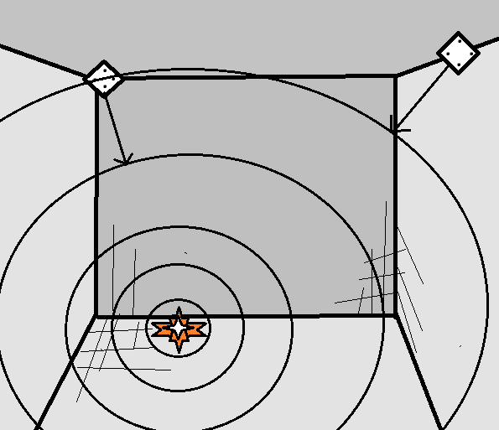
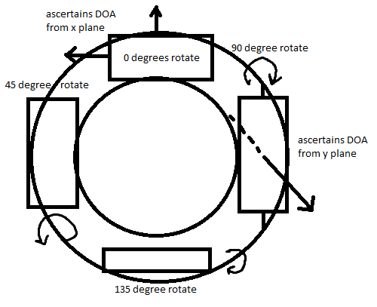
System Architecture (Cont)
Two methods for the mic-array setup are being considered:
Planar mic-arrays using signal strength to localize sound on orthogonal axes
Directionally-based microphone arrays to triangulate the location of the sounds
Design A
Design B

Slide 10
Sub-System Design
Overview
Sound Collection Sub-System
Consists of the microphone arrays (3-4 arrays, with 12-16 microphones in total)
Focuses on receiving audio input
Communications Sub-System
The bluetooth adapter is the main conduit
Receives transmissions from the Sound Collection Sub-System
Sends transmissions to the Data-Processing Sub-System
Software component of this subsystem onboard Raspberry Pi
Data-Processing Sub-System
Consists of the Neural Network and the GUI
Trained machine learning algorithms utilizing python libs process modular data streams from Pi, outputs positional information and associated labels
The GUI will display a scaled map of the surveilled room, with indications toward spots in the room with high sound activity, as well as indications as to the type of sounds picked up

Slide 11
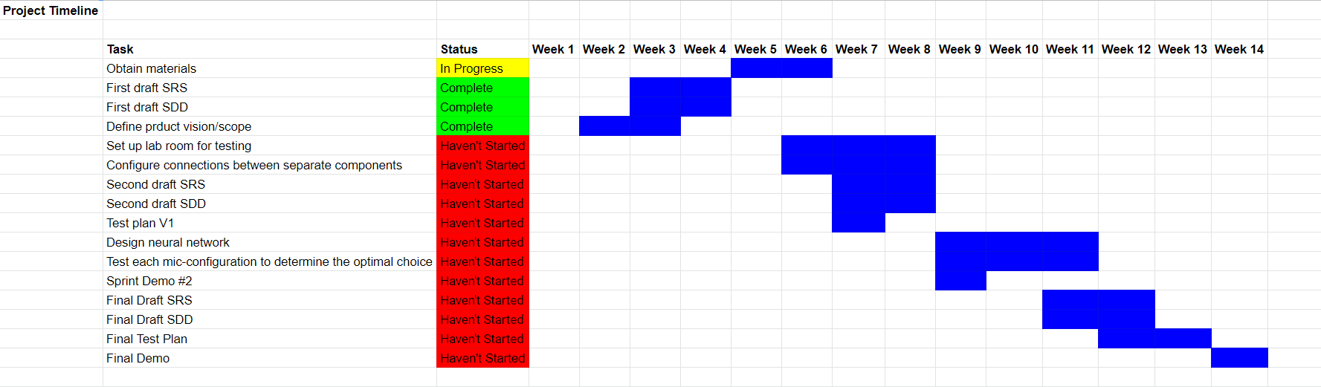
Project Timeline

Slide 12
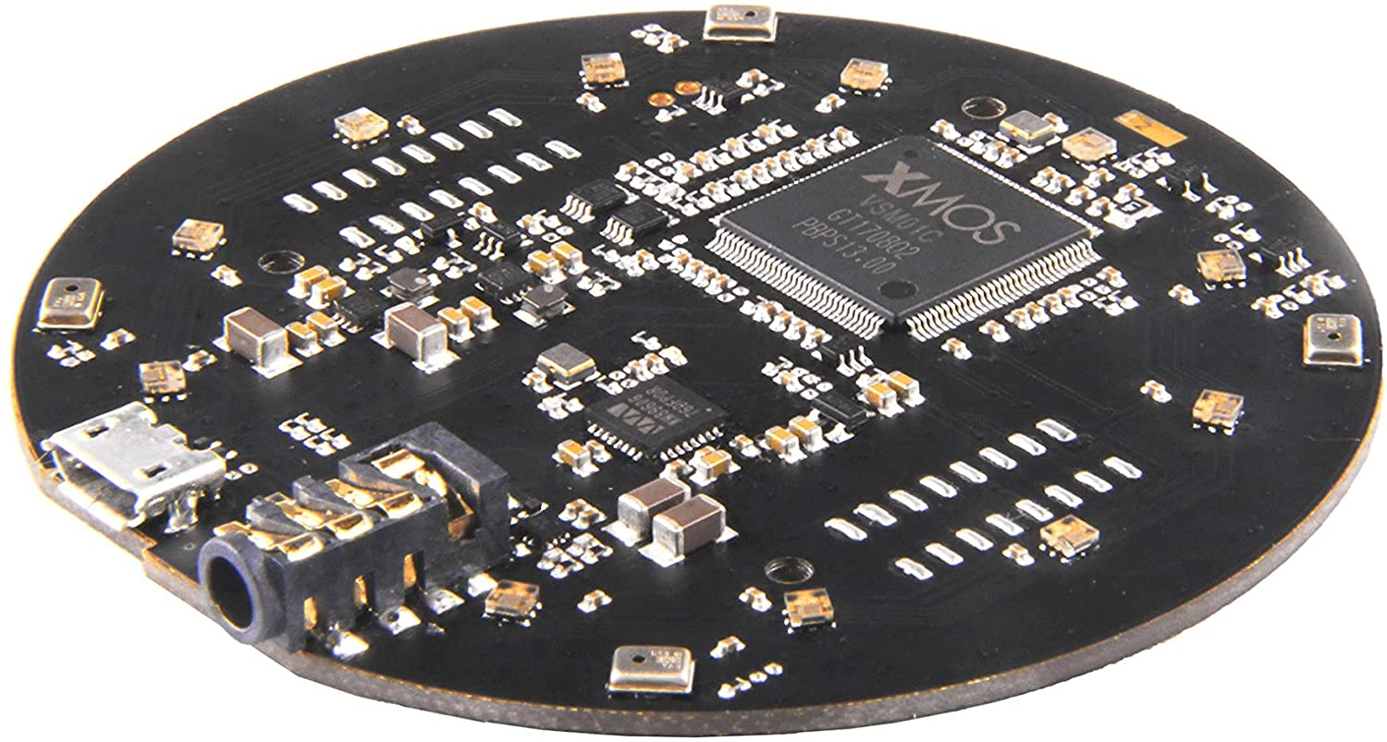
Parts List
Item | Price Total
Raspberry Pi 4 8gb x1 | $0.00
Microphone Array x4 | $284.00
Bluetooth Adapters x5 | $50
MSC Mounting Hardware | $50

Slide 13
Lessons Learned
Regular weekly meetings to better plan and execute tasks
Get started with hardware sooner rather than later

Slide 14
Summary
Introduction
Design Considerations
System Architecture
Sub-System Design
Project Timeline
Parts List

Slide 15
Thank you!
Questions?

